Slide 1
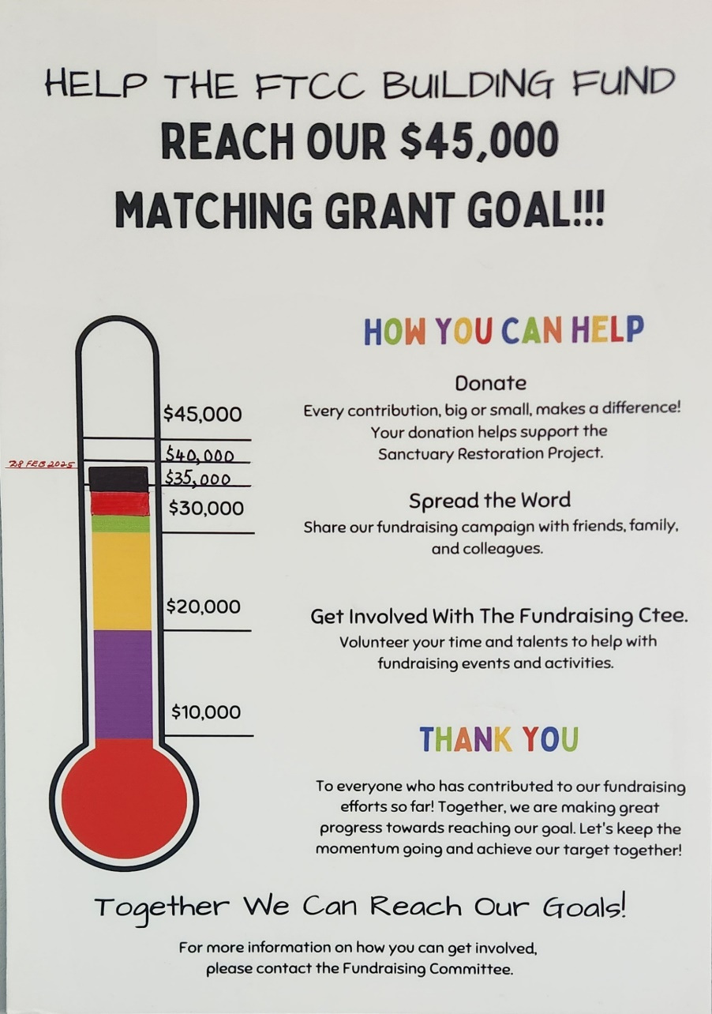
As Of 28-FEB-2025, We Raised:
$38,280.
Proposal To Make The $45,000 Goal
By 5-MAY-2025:
Each Member Makes a Sacrificial Gift of $500:
Ask Family Members, Friends & Co-Workers To Help Create Your Sacrificial Gift.
Payments Can Be Made By:
Zelle: Directly To Treasurer@Flatbushtompkins.org. Memo: “$45K Grant.………Family Gift”
Check/Money Order: Payable To Flatbush Tompkins Congregational Church. Memo: “$45K Grant.………Family Gift”
Cash: A Receipt Will Be Given.

